Slide 1
Marker Gene Selection with ARI Method

Slide 2
We worked with “melanoma” dataset.
Since we know and use the true cells types, this is a supervised method.
Notice that we first removed the cells with unknown cell type, and the remaining dimension is: (23686 genes, 4139 cells)

Slide 3
Basic Idea
For each gene, divide its expressions levels into several clusters. Then use this calculated clustering and the true clustering to assign an ARI value to each gene:
ARI(calculated clustering, true clustering)
Now that we have an ARI value for each gene, we rank them and choose the genes associated with the largest 902 ARI values as the markers (902 is to be consistent with the number of markers selected by SC Marker for fair comparison)
Then we use “Seurat” package to cluster cells based on the markers selected (by SC Marker and by our method). The clustering involves a first step of using PCA and second step of performing Louvian clustering on the first 50 PCs. We compare the results using ARI as the metrics for cell clustering:
ARI for SC Marker: 0.37249
ARI for our method: (to be discussed later)

Slide 4
How do we divide expression levels of each gene into several groups and compute ARI for each gene?

Slide 5
Method 1.1
Motivation: In SC Marker paper, it says that they didn’t use Gaussian Mixture Model because they didn’t know the number of mixture components. But since we know the true cell types, we think it might be possible to apply GMM.
For each gene, we applied the parameterized finite Gaussian mixture model to its expression levels to form a clustering. (This is implemented with ‘mclust’ package in R)
Since fitting the Gaussian mixture model is slow, we first removed genes whose expression level is 0 in more than 95% cells. The remaining dimension is: (13315 genes, 4139 cells)
Resulted ARI = 0.4262677

Slide 6
Method 1.2
Motivation: Since the melanoma dataset has high sparsity, we decided to put cells whose expression level is 0 into 1 group and cluster the remaining cells with gaussian mixture model.
Resulted ARI = 0.3606822
This result is actually worse than that of SC Marker.

Slide 7
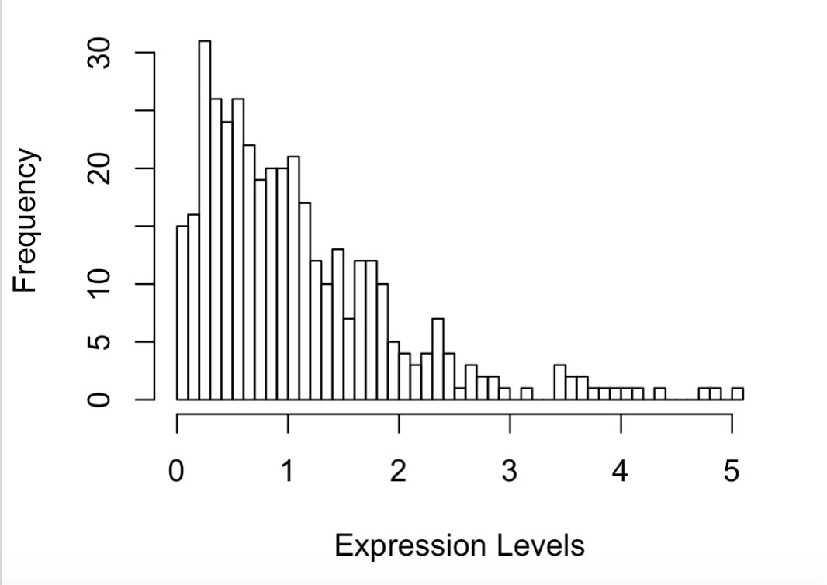
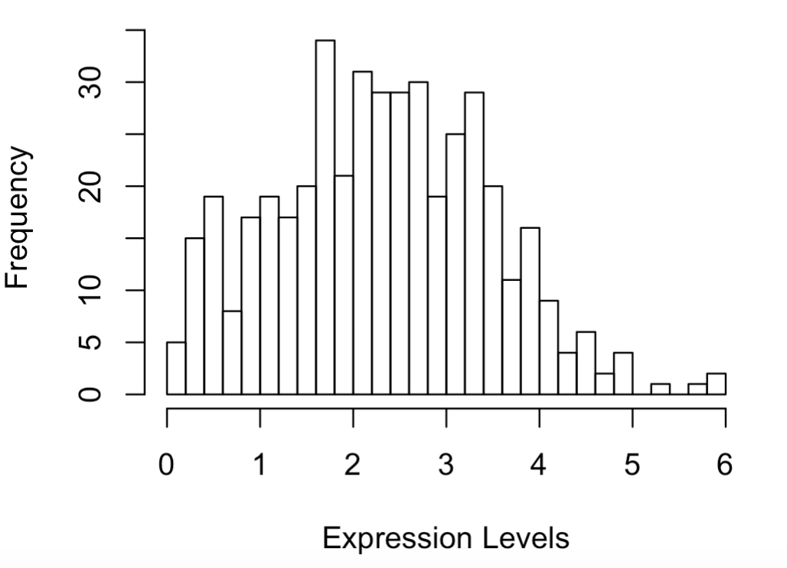
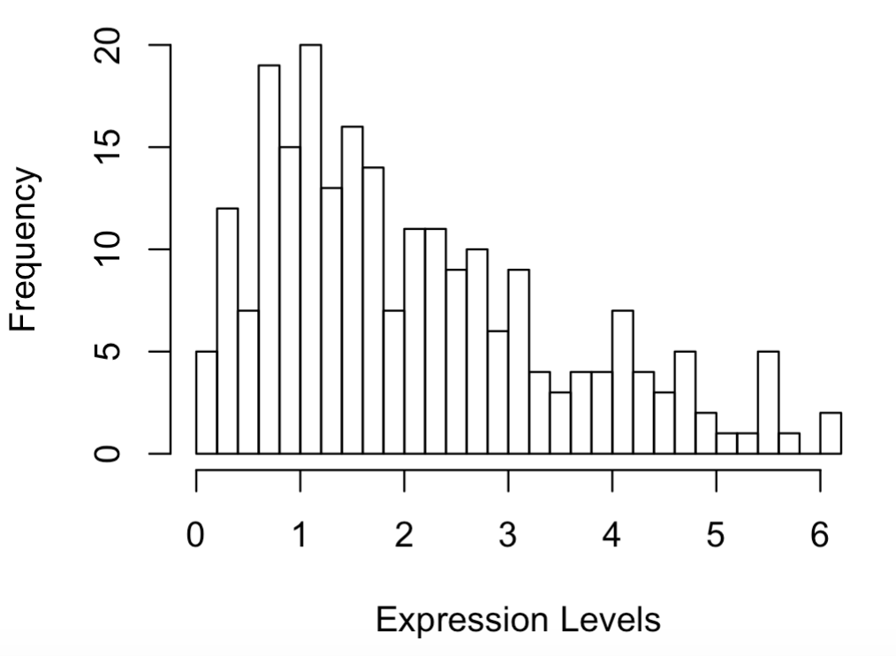
In the previous 2 methods, we let the ‘mclust()’ function itself decide the number of gaussian models to fit.
Then we tried adjusting the number of gaussian models to fit on our own (e.g. 7 because there are 7 true cell types), but didn’t get a much better result.
By fitting gaussian mixture model, we didn’t get a much better result than SC Marker. We inferred the the reason to be that it might not fit the model assumption well. We looked into the histograms of a bunch of genes’ expression levels (either with or without 0’s), and we found many of them not look like mixture of gaussian models. For example:

Slide 8
Method 2.1
For each gene, we split its expression levels into same-sized groups based on the quantiles. i.e. we put cells between two quantiles into one group.
It’s implemented with ‘ntile()’ function in R.
Since ntile() function is much faster than Mclust() function, we kept all the genes.
We first tried splitting into 7 groups, because there are 7 cell types in true labeling.
Resulted ARI = 0.3795651

Slide 9
Since this result is still no better than SC Marker’s, we adjusted the number of groups to split into. We tried number of groups = 7,6,5,4,3,2. And we want to see if there’s any relation between the number of groups and the resulted ARI.
Unluckily, there’s no clear pattern as indicated in the table above, because the resulted ARI fluctuates as the number of groups decreases.
Notice that when number of groups is 5, the resulted ARI is relatively high (0.4410636). However, we can’t find any plausible explanation for it so that might just be a coincidence.
Number of clusters split into | Resulted ARI
7 | 0.3795651
6 | 0.3586774
5 | 0.4410636
4 | 0.4240791
3 | 0.4065269
2 | 0.3450305

Slide 10
Method 2.2
Again, due to the high sparsity of melanoma dataset, for each gene, we put expression levels of 0 into 1 group and group the remaining cells based on the quantiles.
We first split the remaining cells into 6 groups, so that there are 7 groups in total (the first group is composed of all 0’s)
Resulted ARI = 0.3874056

Slide 11
Again, we tried adjusting the number of groups split into when doing ntile(). We tried number of groups = 6,5,4,3,2,1 (with the actual number of groups = 7,6,5,4,3,2 because of the additional group full of 0’s)
Number of clusters split into | Resulted ARI
7 | 0.3874056
6 | 0.3914178
5 | 0.3925514
4 | 0.3907454
3 | 0.3994951
2 | 0.3908529
We can see that the resulted ARI remains almost the same when number of groups decreases.

Slide 12
Method 2.3
Motivation: Different genes can separate different cell types. For example, a gene may be able to separate T-Cells and B-Cells, while another gene may be able to separate malignant cells, Endothelial cells and Macrophages. Thus, it’s not intuitive to choose the same number of groups for all genes and do the comparison.
In this method, we tried different numbers of groups (2-7) for each gene, so for each gene we can get 6 ARI values and we select the highest one as the ARI value for that gene. Then we can use the genes with top 902 ARIs values as the markers.
Resulted ARI = 0.388936

Slide 13
Method 2.4
Similar to Method 2.3.
Here, for each gene, we just put 0’s in expression levels into one group when we do the grouping.
Resulted ARI = 0.4561111
This is the highest ARI we have achieved so far, and it’s interpretable.

Slide 14
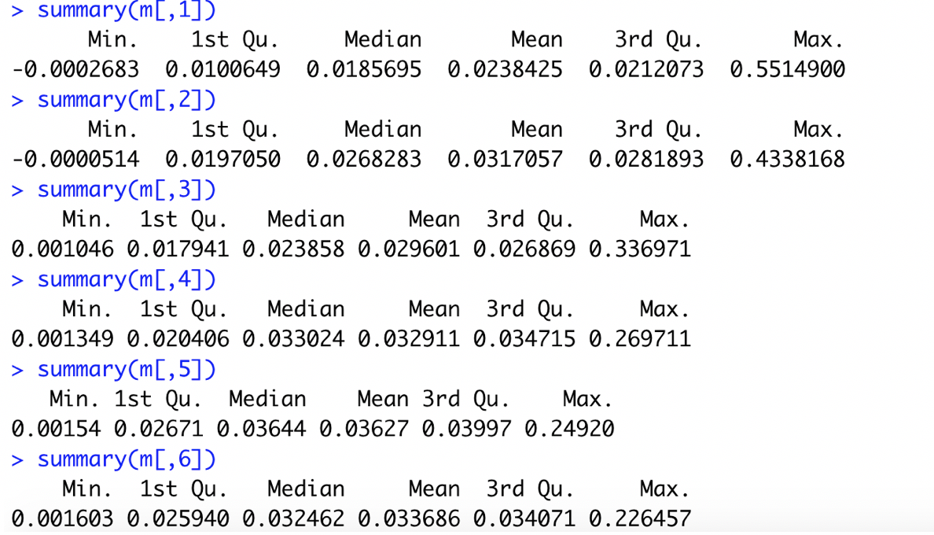
Method 2.5
In Method 2.3, we got 6 ARI values for each gene, each value corresponds to a different number of groups (2-7). So we got a matrix that looks like:
Then we looked into the summary of each column:
 | 2 groups | 3 groups | 4 groups | 5 groups | 6 groups | 7 groups
ARI for gene1
ARI for gene2
We observed that:
When the number of groups increases, the max of all
genes’ ARIs decreases.

Slide 15
Intuitively, we would want each marker gene to separate as many cell types as possible, so we want to give genes that can separate more cell types an advantage. We observed that the max ARI value decreases as the number of groups decreases, so the genes that can separate less cell types actually have an advantage. Therefore, we took away that advantage by normalizing each column by its max value.
Then we performed a similar procedure as Method 2.3 by selecting the highest ARI value as the ARI value for each gene, then select the top 902 genes.
Resulted ARI = 0.4250419

Slide 16
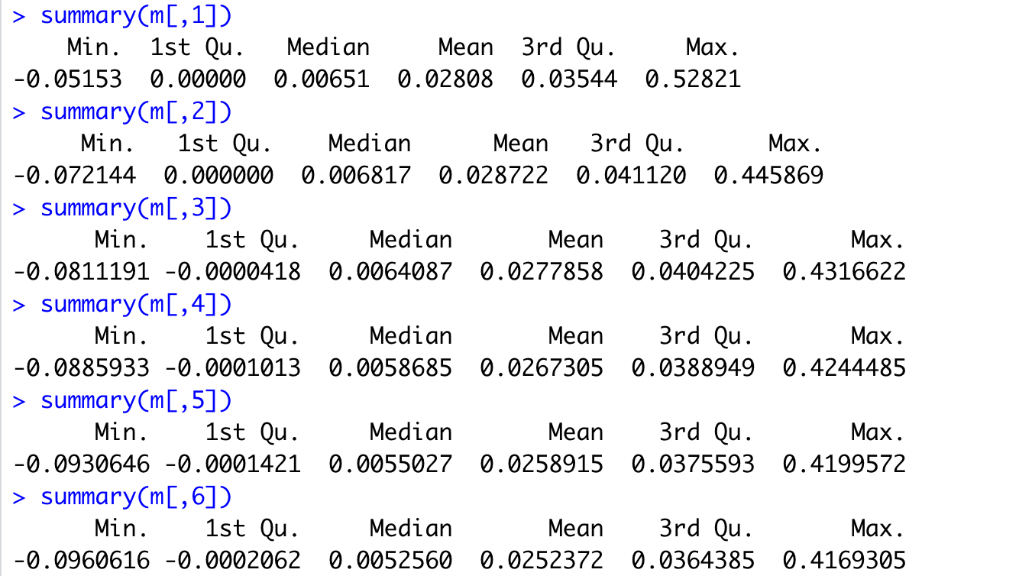
Method 2.6
Similar to Method 2.5
Here, for each gene, we just put 0’s in expression levels into one group when we do the grouping.
Looking into the summary of each column:
Again, we found that:
When the number of groups increases, the max of all genes’ ARIs decreases.
Therefore, we can perform normalization on each column by its max value as before.
Resulted ARI = 0.4436033
This result also looks good.

Slide 17
Method 2.7
Motivation: This is a supervised method, so we want to utilize the known cell type information as much as possible. Therefore, we no longer split the expression levels into same-sized groups. Instead, we split them into different-sized groups whose sizes are determined by the sizes of true cell clusters.
There are 4139 cells in total and 7 cell types, and the size for each cell type group is: (2064, 515, 125, 65, 61, 52, 1257).
So when we group the cells based on the expression levels of each gene, we split into 7 groups with sizes indicated above.
However, one question is that: how do we order the groups? In other words, which quantile should each group correspond to?
E.g. (2064, 515, 125, 65, 61, 52, 1257) -> (0%-50%, 51%-62%, 63%-65%, 66%-67%, 68%-69%, 70%-71%, 72%-100%)
OR (515, 2064, 1257, 65, 61, 52, 125) -> (0%-12%, 13%-62%, 63%-91%, 92%-93%, 94%-95%, 96%-97%, 98%-100%)?

Slide 18
Solution: For each gene, we calculated the max expression level for each cell type group and used it as a metric to order the groups. (We didn’t use the mean/median as a metric because the high sparsity of the dataset may make the mean/median to be 0)
An example:
Suppose the order of groups for one gene looks like: (515, 2064, 1257, 65, 61, 52, 125). We order the expression levels and then take the first 515 into the first group, the next 2064 into the second group, the next 1257 into the third group, and so on.
Resulted ARI = 0.3809749
Not much improvement. We inferred the reason to be that not all genes can separate all the 7 cell types, so it may not be advisable to make the number of groups to be 7 for all genes.

Slide 19
Conclusion
The result of Method 2.4 is the best (ARI = 0.4561111).
The result of Method 2.6 is also comparable (ARI = 0.4436033).
Both methods put 0’s into one group when performing clustering based on each gene’s expression levels. Thus, taking into account of the sparsity of melanoma dataset is necessary.
Compared to the ARI achieved by SC Marker: 0.37249, our method has made some improvement. However, as a supervised method, the improvement may be not so significant. We aim to reach an ARI of 0.5

Slide 20
Future steps
Test on some other datasets, such as the HNSCC dataset, to see if the result is consistent.
Try some other clustering algorithm on the marker genes, such as K-means.
In Method 2.7, we could figure out a way that takes advantage of the size of true cell type clusters but doesn’t limit the number of groups to split to be 7.
In Method 2.2, we put 0’s into one group and found that the ARI remains almost the same regardless of the number of groups split into. We can check whether the marker genes selected overlap much. If they overlap much, then the group composed of 0’s should have a dominating effect, which confirms the necessity of taking into account the sparsity of dataset.

